Slide 1
Software Quality Assurance
/
Software Quality Engineering
Lecture 7
Naseer Ahmed

Slide 2
White Box Testing
The one box testing approach of software testing is white box testing.
White box testing which also known as
glass box testing
structural testing
clear box testing
open box testing
transparent box testing.
It tests internal coding and infrastructure of a software focus on checking of predefined inputs against expected and desired outputs.
It is based on inner workings of an application and revolves around internal structure testing.

Slide 3
White Box Testing
In this type of testing programming skills are required to design test cases. The primary goal of white box testing is to focus on the flow of inputs and outputs through the software and strengthening the security of the software.
The term 'white box' is used because of the internal perspective of the system. The clear box or white box or transparent box name denote the ability to see through the software's outer shell into its inner workings.
Developers do white box testing. In this, the developer will test every line of the code of the program. The developers perform the White-box testing and then send the application or the software to the testing team.

Slide 4
White Box Testing
The developer fixes the bugs and does one round of white box testing and sends it to the testing team. Here, fixing the bugs implies that the bug is deleted, and the particular feature is working fine on the application.
The test engineers will not include in fixing the defects for the following reasons:
Fixing the bug might interrupt the other features.
If the test engineers spend most of the time fixing the defects, then they may be unable to find the other bugs in the application.

Slide 5
White Box Testing
The white box testing contains various tests, which are as follows:
Path testing
Loop testing
Condition testing
Testing based on the memory perspective
Test performance of the program

Slide 6
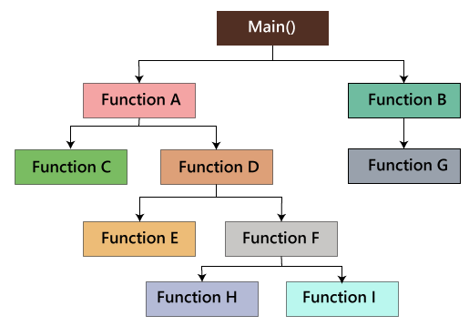
White Box Testing
Path testing:
In the path testing, we will write the flow graphs and test all independent paths.

Slide 7
White Box Testing
Loop testing:
In the loop testing, we will test the loops such as while, for, and do-while, etc. and also check for ending condition if working correctly and if the size of the conditions is enough.
For example: we have one program where the developers have given about 50,000 loops.
We cannot test this program manually for all the 50,000 loops cycle. So we write a small program that helps for all 50,000 cycles.
We can write a test P Program which is written in the similar language as the source code program, and this is known as a Unit test. And it is written by the developers only.

Slide 8
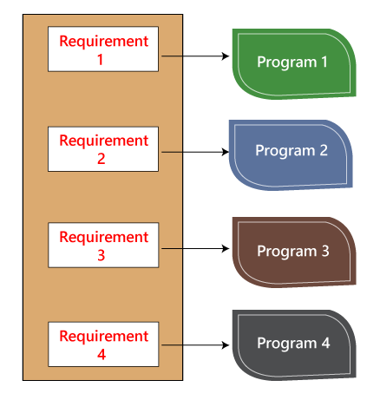
White Box Testing
Loop testing:
we have various requirements such as 1, 2, 3, 4. And then, the developer writes the programs such as program 1,2,3,4 for the parallel conditions.

Slide 9
White Box Testing
Loop testing:
The developer will do the white box testing, and they will test all the five programs line by line of code to find the bug. If they found any bug in any of the programs, they will correct it. And they again have to test the system then this process contains lots of time and effort and slows down the product release time.
Now, suppose we have another case, where the clients want to modify the requirements, then the developer will do the required changes and test all four program again.

Slide 10
White Box Testing
Conditional testing:
In this, we will test all logical conditions for both true and false values; that is, we will verify for both if and else condition.
The program will work fine for both
the conditions, which means
that if the condition is accurate,
and then else should be false
and conversely.
For example:
if(condition) - true
{
……
……
}
else - false
{
…..
……
}

Slide 11
White Box Testing
Testing based on the memory (size) perspective
The size of the code is increasing for the following reasons:
The reuse of code is not there: let us take one example, where we have four programs of the same application, and the first ten lines of the program are similar. We can write these ten lines as a discrete function, and it should be accessible by the above four programs as well. And also, if any bug is there, we can modify the line of code in the function rather than the entire code.
The developers use the logic that might be modified. If one programmer writes code and the file size is up to 250kb, then another programmer could write a similar code using the different logic, and the file size is up to 100kb.

Slide 12
White Box Testing
Testing based on the memory (size) perspective
The developer declares so many functions and variables that might never be used in any portion of the code. Therefore, the size of the program will increase.
In the code, we can see that
the integer a has never been
called anywhere in the program,
and also the function
Create user has never been
called anywhere in the code.
Therefore, it leads us to memory
consumption.
Int a=15;
Int b=20;
String S= "Welcome";
….
…..
Int p=b;
Create user()
{
……
….. 200's line of code
}

Slide 13
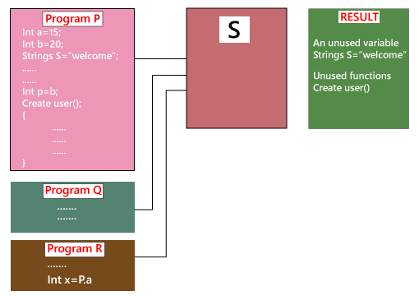
White Box Testing
Testing based on the memory (size) perspective
We cannot remember this type of mistake manually by verifying the code because of the large code. So, we have a built-in tool, which helps us to test the needless variables and functions. We have the tool called Rational purify.

Slide 14
White Box Testing
Test the performance (Speed, response time) of the program
The application could be slow for the following reasons:
When logic is used.
For the conditional cases, we will use or & and adequately.
Switch case, which means we cannot use nested if, instead of using a switch case.

Slide 15
White Box Testing
Generic steps of white box testing
Design all test scenarios, test cases and prioritize them according to high priority number.
This step involves the study of code at runtime to examine the resource utilization, not accessed areas of the code, time taken by various methods and operations and so on.
In this step testing of internal subroutines takes place. Internal subroutines such as nonpublic methods, interfaces are able to handle all types of data appropriately or not.
This step focuses on testing of control statements like loops and conditional statements to check the efficiency and accuracy for different data inputs.
In the last step white box testing includes security testing to check all possible security loopholes by looking at how the code handles security.

Slide 16
White Box Testing
Reasons for white box testing
It identifies internal security holes.
To check the way of input inside the code.
Check the functionality of conditional loops.
To test function, object, and statement at an individual level.
Advantages of White box testing
White box testing optimizes code so hidden errors can be identified.
Test cases of white box testing can be easily automated.
This testing is more thorough than other testing approaches as it covers all code paths.
It can be started in the SDLC phase even without GUI.

Slide 17
White Box Testing
Disadvantages of White box testing
White box testing is too much time consuming when it comes to large-scale programming applications.
White box testing is much expensive and complex.
It can lead to production error because it is not detailed by the developers.
White box testing needs professional programmers who have a detailed knowledge and understanding of programming language and implementation.

Slide 18
White Box Testing
Techniques Used in White Box Testing
Data Flow Testing:
Data flow testing is used to analyze the flow of data in the program. It is the process of collecting information about how the variables flow the data in the program. It tries to obtain particular information of each particular point in the process.
Data flow testing uses the control flow graph to detect illogical things that can interrupt the flow of data. Anomalies in the flow of data are detected at the time of associations between values and variables due to:
If the variables are used without initialization.
If the initialized variables are not used at least once.

Slide 19
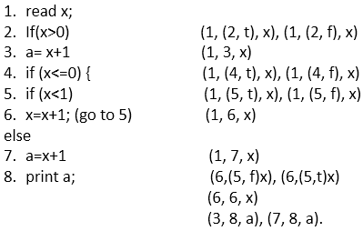
White Box Testing
Techniques Used in White Box Testing
Data Flow Testing:
In this code, we have a
total 8 statements, and we will
choose a path which covers
all the 8 statements.
As it is evident in the code,
we cannot cover all the
statements in a single path
because if statement 2
is true then statements 4, 5, 6, 7 not covered, and if statement 4 is true then statement 2 and 3 are not covered.
So, we are taking two paths to cover all the statements.

Slide 20
White Box Testing
Techniques Used in White Box Testing
Control Flow Testing:
Control flow testing is a testing technique that comes under white box testing. The aim of this technique is to determine the execution order of statements or instructions of the program through a control structure. The control structure of a program is used to develop a test case for the program. In this technique, a particular part of a large program is selected by the tester to set the testing path. It is mostly used in unit testing. Test cases represented by the control graph of the program.
Control Flow Graph is formed from the node, edge, decision node, junction node to specify all possible execution path.

Slide 21
White Box Testing
Techniques Used in White Box Testing
Control Flow Testing:

Slide 22
White Box Testing
Techniques Used in White Box Testing
Branch Testing:
Branch coverage technique is used to cover all branches of the control flow graph. It covers all the possible outcomes (true and false) of each condition of decision point at least once. Branch coverage technique is a whitebox testing technique that ensures that every branch of each decision point must be executed.

Slide 23
White Box Testing
Techniques Used in White Box Testing
Branch Testing:
Read X
Read Y
IF X+Y > 100 THEN
Print "Large"
ENDIF
If X + Y<100 THEN
Print "Small"
ENDIF
This is the basic code structure where we took two variables X and Y and two conditions. If the first condition is true, then print "Large" and if it is false, then go to the next condition. If the second condition is true, then print "Small."

Slide 24
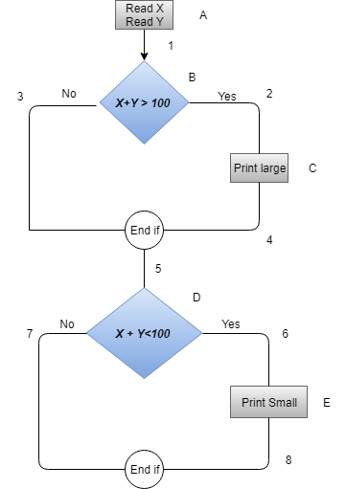
White Box Testing
Techniques Used in White Box Testing
Branch Testing:
Case | Covered Branches | Path | Branch coverage
Yes | 1, 2, 4, 5, 6, 8 | A1-B2-C4-D6-E8 | 2
No | 3,7 | A1-B3-5-D7

Slide 25
White Box Testing
Techniques Used in White Box Testing
Statement Testing:
Statement coverage is one of the widely used software testing. It comes under white box testing.
Statement coverage technique is used to design white box test cases. This technique involves execution of all statements of the source code at least once. It is used to calculate the total number of executed statements in the source code out of total statements present in the source code.
Statement coverage derives scenario of test cases under the white box testing process which is based upon the structure of the code.

Slide 26
White Box Testing
Techniques Used in White Box Testing
Statement Testing:
Generally, in the internal source code, there is a wide variety of elements like operators, methods, arrays, looping, control statements, exception handlers, etc. Based on the input given to the program, some code statements are executed and some may not be executed. The goal of statement coverage technique is to cover all the possible executing statements and path lines in the code.

Slide 27
White Box Testing
Techniques Used in White Box Testing
Statement Testing:
Source Code Structure:
Take input of two values like a=0 and b=1.
Find the sum of these two values.
If the sum is greater than 0, then print "This is the positive result."
If the sum is less than 0, then print "This is the negative result.“

Slide 28
White Box Testing
Techniques Used in White Box Testing
Statement Testing:
Source Code Structure:
Prints (int a, int b) { ------------ Print sum is a function
int result = a+ b;
If (result> 0)
Print ("Positive", result)
Else
Print ("Negative", result)
} ----------- End of the source code

Slide 29
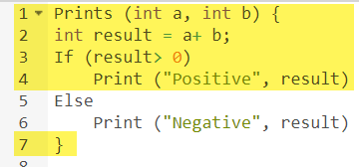
White Box Testing
Techniques Used in White Box Testing
Statement Testing:
Source Code Structure:
Scenario 1:
If A = 3, B = 9
The statements marked in yellow color are those which are executed as per the scenario
Number of executed statements = 5, Total number of statements = 7
Statement Coverage: 5/7 = 71%

Slide 30
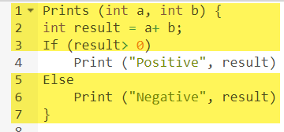
White Box Testing
Techniques Used in White Box Testing
Statement Testing:
Source Code Structure:
Scenario 2:
If A = -3, B = -9
The statements marked in yellow color are those which are executed as per the scenario
Number of executed statements = 5, Total number of statements = 7
Statement Coverage: 6/7 = 85%

Slide 31
White Box Testing
Techniques Used in White Box Testing
Decision Coverage:
Decision Coverage is a white box testing technique which reports the true or false outcomes of each boolean expression of the source code. The goal of decision coverage testing is to cover and validate all the accessible source code by checking and ensuring that each branch of every possible decision point is executed at least once.
In this coverage, expressions can sometimes get complicated. Therefore, it is very hard to achieve 100% coverage. That's why there are many different methods of reporting this metric. All these methods focus on covering the most important combinations. It is very much similar to decision coverage, but it offers better sensitivity to control flow.

Slide 32

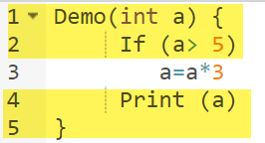
White Box Testing
Techniques Used in White Box Testing
Decision Coverage:
Consider the following code-
Demo(int a) {
If (a> 5)
a=a*3
Print (a)
}
Scenario 1:
Value of a is 2
The code highlighted in yellow will be executed. Here the "No" outcome of the decision If (a>5) is checked.
Decision Coverage = 50%

Slide 33
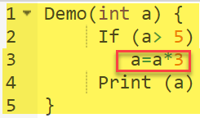
White Box Testing
Techniques Used in White Box Testing
Decision Coverage:
Scenario 2:
Value of a is 6
The code highlighted in yellow will be executed. Here the "Yes" outcome of the decision If (a>5) is checked.
Decision Coverage = 50%
Test Case | Value of A | Output | Decision Coverage
1 | 2 | 2 | 50%
2 | 6 | 18 | 50%

Slide 34
Black Box Testing
Black box testing is a technique of software testing which examines the functionality of software without peering into its internal structure or coding. The primary source of black box testing is a specification of requirements that is stated by the customer.
In this method, tester selects a function and gives input value to examine its functionality, and checks whether the function is giving expected output or not. If the function produces correct output, then it is passed in testing, otherwise failed. The test team reports the result to the development team and then tests the next function. After completing testing of all functions if there are severe problems, then it is given back to the development team for correction.

Slide 35
Black Box Testing
Generic steps of black box testing:
The black box test is based on the specification of requirements, so it is examined in the beginning.
In the second step, the tester creates a positive test scenario and an adverse test scenario by selecting valid and invalid input values to check that the software is processing them correctly or incorrectly.
In the third step, the tester develops various test cases such as decision table, all pairs test, equivalent division, error estimation, cause-effect graph, etc.
The fourth phase includes the execution of all test cases.
In the fifth step, the tester compares the expected output against the actual output.
In the sixth and final step, if there is any flaw in the software, then it is cured and tested again.

Slide 36
Black Box Testing
Test procedure:
The test procedure of black box testing is a kind of process in which the tester has specific knowledge about the software's work, and it develops test cases to check the accuracy of the software's functionality.
It does not require programming knowledge of the software. All test cases are designed by considering the input and output of a particular function. A tester knows about the definite output of a particular input, but not about how the result is arising.

Slide 37
Black Box Testing
Test cases:
Test cases are created considering the specification of the requirements. These test cases are generally created from working descriptions of the software including requirements, design parameters, and other specifications. For the testing, the test designer selects both positive test scenario by taking valid input values and adverse test scenario by taking invalid input values to determine the correct output. Test cases are mainly designed for functional testing but can also be used for non-functional testing. Test cases are designed by the testing team, there is not any involvement of the development team of software.

Slide 38
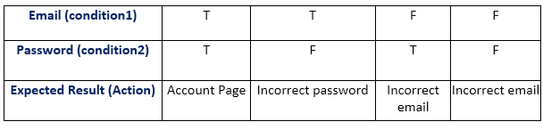
Black Box Testing
Techniques Used in Black Box Testing:
Decision Table Technique:
Decision Table Technique is a systematic approach where various input combinations and their respective system behavior are captured in a tabular form. It is appropriate for the functions that have a logical relationship between two and more than two inputs.
Now, let's see how a decision table is created for the login function in which we can log in by using email and password. Both the email and the password are the conditions, and the expected result is action.

Slide 39
Black Box Testing
Techniques Used in Black Box Testing:
Decision Table Technique:
Decision Table Technique is a systematic approach where various input combinations and their respective system behavior are captured in a tabular form. It is appropriate for the functions that have a logical relationship between two and more than two inputs.
Now, let's see how a decision table is created for the login function in which we can log in by using email and password. Both the email and the password are the conditions, and the expected result is action.

Slide 40
Black Box Testing
Techniques Used in Black Box Testing:
Decision Table Technique:
In order to find the number of all possible conditions, tester uses 2n formula where n denotes the number of inputs; in the example there is the number of inputs is 2 (one is true and second is false).
Number of possible conditions = 2^ Number of Values of the second condition
Number of possible conditions =2^2 = 4

Slide 41
Black Box Testing
Techniques Used in Black Box Testing:
Boundary Value Technique:
Boundary Value Technique is used to test boundary values, boundary values are those that contain the upper and lower limit of a variable. It tests, while entering boundary value whether the software is producing correct output or not.
Boundary values are those that contain the upper and lower limit of a variable. Assume that, age is a variable of any function, and its minimum value is 18 and the maximum value is 30, both 18 and 30 will be considered as boundary values.
The basic assumption of boundary value analysis is, the test cases that are created using boundary values are most likely to cause an error.

Slide 42
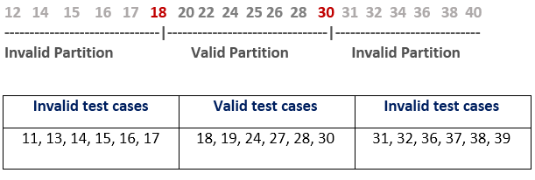
Black Box Testing
Techniques Used in Black Box Testing:
Boundary Value Technique:
Let's understand via practical:

Slide 43
Black Box Testing
Techniques Used in Black Box Testing:
State Transition Technique:
State Transition Technique is used to capture the behavior of the software application when different input values are given to the same function. This applies to those types of applications that provide the specific number of attempts to access the application.
There is a login function of an application which provides a maximum three number of attempts, and after exceeding three attempts, it will be directed to an error page.

Slide 44
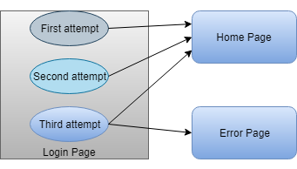
Black Box Testing
Techniques Used in Black Box Testing:
State Transition Technique:
State transition table
STATE | LOGIN | VALIDATION | REDIRECTED
S1 | First Attempt | Invalid | S2
S2 | Second Attempt | Invalid | S3
S3 | Third Attempt | Invalid | S5
S4 | Home Page
S5 | Error Page

Slide 45
Black Box Testing
Techniques Used in Black Box Testing:
All-pair Testing Technique:
All-pair testing Technique is used to test all the possible discrete combinations of values. This combinational method is used for testing the application that uses checkbox input, radio button input, list box, text box, etc.
Assume that there is a function with a list box that contains 10 elements, text box that can accept 1 to 100 characters, radio button, checkbox and OK button.

Slide 46
Black Box Testing
Techniques Used in Black Box Testing:
All-pair Testing Technique:
The input values are given below that can be accepted by the fields of the given function.
Check Box - Checked or Unchecked
List Box - 0, 1, 2, 3, 4, 5, 6, 7, 8, 9,
Radio Button - On or Off
Text Box - Number of alphabets between 1 to 100.
OK - Does not accept any value, only redirects to the next page.

Slide 47
Black Box Testing
Techniques Used in Black Box Testing:
All-pair Testing Technique:
Text box | List Box | Check Box | Radio Button
Valid Integer | 0 | Check | ON
Invalid Integer | Other | Uncheck | OFF
Valid Integer | 0 | Check | ON
Invalid Integer | Other | Uncheck | OFF
AlphaSpecialCharacter | 0 | Check | ON
AlphaSpecialCharacter | Other | Uncheck | OFF

Slide 48
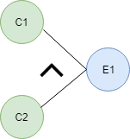
Black Box Testing
Techniques Used in Black Box Testing:
Cause-Effect Technique:
Cause-Effect Technique underlines the relationship between a given result and all the factors affecting the result. It is based on a collection of requirements.
Cause-Effect graph technique converts the requirements specification into a logical relationship between the input and output conditions by using logical operators like AND, OR and NOT.
AND - E1 is an effect and C1 and C2 are the causes. If both C1 and C2 are true, then effect E1 will be true.

Slide 49
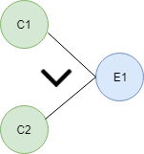

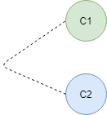
Black Box Testing
Techniques Used in Black Box Testing:
Cause-Effect Technique:
OR - If any cause from C1 and C2 is true, then effect E1 will be true.
NOT - If cause C1 is false, then effect E1 will be true.
Mutually Exclusive - When only one cause is true.

Slide 50
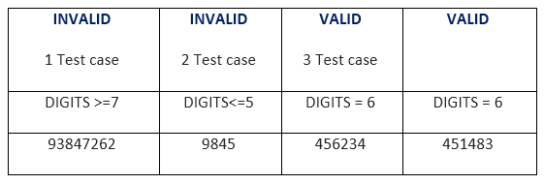
Black Box Testing
Techniques Used in Black Box Testing:
Equivalence Partitioning Technique:
Equivalence partitioning is a technique of software testing in which input data divided into partitions of valid and invalid values, and it is mandatory that all partitions must exhibit the same behavior.
The equivalence partitions are derived from requirements and specifications of the software. The advantage of this approach is, it helps to reduce the time of testing due to a smaller number of test cases from infinite to finite. It is applicable at all levels of the testing process.
Example:
OTP Number = 6 digits

Slide 51
Black Box Testing
Techniques Used in Black Box Testing:
Error Guessing Technique:
Error guessing is a technique in which there is no specific method for identifying the error. It is based on the experience of the test analyst, where the tester uses the experience to guess the problematic areas of the software.
Error guessing is a technique in which there is no specific method for identifying the error. It is based on the experience of the test analyst, where the tester uses the experience to guess the problematic areas of the software. It is a type of black box testing technique which does not have any defined structure to find the error.

Slide 52
Black Box Testing
Techniques Used in Black Box Testing:
Error Guessing Technique:
In this approach, every test engineer will derive the values or inputs based on their understanding or assumption of the requirements, and we do not follow any kind of rules to perform error guessing technique.
The accomplishment of the error guessing technique is dependent on the ability and product knowledge of the tester because a good test engineer knows where the bugs are most likely to be, which helps to save lots of time.

Slide 53
Black Box Testing
Techniques Used in Black Box Testing:
Use Case Technique:
Use case Technique used to identify the test cases from the beginning to the end of the system as per the usage of the system. By using this technique, the test team creates a test scenario that can exercise the entire software based on the functionality of each function from start to end.
By using this technique, the test team creates a test scenario that can exercise the entire software based on the functionality of each function from start to end.
It is a graphic demonstration of business needs, which describe how the end-user will cooperate with the software or the application. The use cases provide us all the possible techniques of how the end-user uses the application

Slide 54
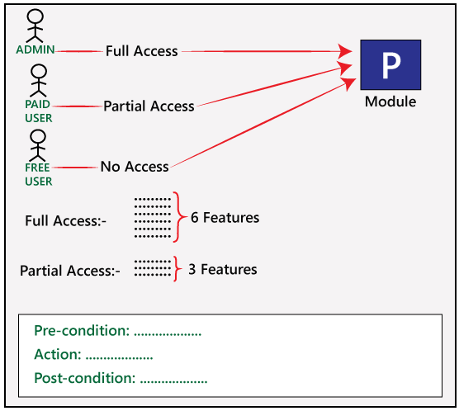
Black Box Testing
Techniques Used in Black Box Testing:
Use Case Technique:

Slide 55
Black Box Testing
Techniques Used in Black Box Testing:
Use Case Technique:
Admin has access to all the six features, the Paid user has access to the three features and for the Free user, there is no access provided to any of the features.
Like for Admin, the different conditions would be as below:
Pre-condition→ Admin must be generated
Action→ Login as Paid user
Post-condition→ 3 features must be present
And for Free user, the different condition would be as below:
Pre-condition→ free user must be generated
Action→ Login as a free user
Post-condition→ no features

Slide 56
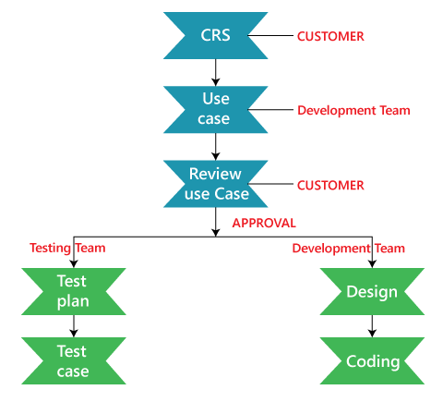
Black Box Testing
Techniques Used in Black Box Testing:
Use Case Technique:
Who writes the use case?
The client provides the customer requirement specification for the application, then the development team will write the use case according to the CRS, and the use case is sent to the customer for their review.

Slide 57
Greybox testing
Greybox testing is a software testing method to test the software application with partial knowledge of the internal working structure. It is a combination of black box and white box testing because it involves access to internal coding to design test cases as white box testing and testing practices are done at functionality level as black box testing.
GreyBox testing commonly identifies context-specific errors that belong to web systems. For example; while testing, if tester encounters any defect then he makes changes in code to resolve the defect and then test it again in real time. It concentrates on all the layers of any complex software system to increase testing coverage. It gives the ability to test both presentation layer as well as internal coding structure.

Slide 58
Greybox testing
Why GreyBox testing?
Reasons for GreyBox testing are as follows
It provides combined benefits of both Blackbox testing and WhiteBox testing.
It includes the input values of both developers and testers at the same time to improve the overall quality of the product.
It reduces time consumption of long process of functional and non-functional testing.
It gives sufficient time to the developer to fix the product defects.
It includes user point of view rather than designer or tester point of view.
It involves examination of requirements and determination of specifications by user point of view deeply.

Slide 59
Greybox testing
GreyBox Testing Strategy:
Grey box testing does not make necessary that the tester must design test cases from source code. To perform this testing test cases can be designed on the base of, knowledge of architectures, algorithm, internal states or other high -level descriptions of the program behavior. It uses all the straightforward techniques of black box testing for function testing. The test case generation is based on requirements and preset all the conditions before testing the program by assertion method.

Slide 60
Greybox testing
GreyBox Testing Strategy:
Generic Steps to perform Grey box Testing are:
First, select and identify inputs from BlackBox and WhiteBox testing inputs.
Second, Identify expected outputs from these selected inputs.
Third, identify all the major paths to traverse through during the testing period.
The fourth task is to identify sub-functions which are the part of main functions to perform deep level testing.
The fifth task is to identify inputs for subfunctions.
The sixth task is to identify expected outputs for subfunctions.
The seventh task includes executing a test case for Subfunctions.
The eighth task includes verification of the correctness of result.
The test cases designed for Greybox testing includes Security related, Browser related, GUI related, Operational system related and Database related testing.

Slide 61
Greybox testing
Techniques of Grey box Testing:
Matrix Testing:
This testing technique comes under Grey Box testing. It defines all the used variables of a particular program. In any program, variable are the elements through which values can travel inside the program. It should be as per requirement otherwise, it will reduce the readability of the program and speed of the software. Matrix technique is a method to remove unused and uninitialized variables by identifying used variables from the program.

Slide 62
Greybox testing
Techniques of Grey box Testing:
Regression Testing:
Regression testing is used to verify that modification in any part of software has not caused any adverse or unintended side effect in any other part of the software. During confirmation testing, any defect got fixed, and that part of software started working as intended, but there might be a possibility that fixed defect may have introduced a different defect somewhere else in the software. So, regression testing takes care of these type of defects by testing strategies like retest risky use cases, retest within a firewall, retest all, etc.

Slide 63
Greybox testing
Techniques of Grey box Testing:
Orthogonal Array Testing or OAT:
The purpose of this testing is to cover maximum code with minimum test cases. Test cases are designed in a way that can cover maximum code as well as GUI functions with a smaller number of test cases.

Slide 64
Greybox testing
Techniques of Grey box Testing:
Pattern Testing:
Pattern testing is applicable to such type of software that is developed by following the same pattern of previous software. In these type of software possibility to occur the same type of defects. Pattern testing determines reasons of the failure so they can be fixed in the next software.
Usually, automated software testing tools are used in Greybox methodology to conduct the test process. Stubs and module drivers provided to a tester to relieve from manually code generation.

